Slide 1


Capstone Project – Movie Rental Analytics

Slide 2



Objective: The objective of this project is to create a comprehensive Power BI dashboard utilizing the Sample Publication Database. The dashboard aims to provide valuable insights into the publishing company's book sales performance, author royalties, and store distribution, enabling data-driven decision-making and strategic planning.
Analysis Scope: The analysis will focus on various aspects of the publication process, including book sales, author contributions, store performance, and the impact of discounts. It will encompass historical sales data, author royalties based on royalty schedules, and distribution data from multiple bookstores.
Goal: The primary goal of this Power BI dashboard is to offer a holistic view of the publishing company's operations. It will provide actionable insights to optimize book sales, enhance author collaboration, improve store distribution strategies, and identify opportunities for growth and efficiency.

Slide 3


Insights & Recommendations: The Power BI dashboard will generate valuable insights into the top-selling book titles, bestselling genres, and sales trends over time. It will analyze the performance of different bookstores, identify bestselling authors, and calculate author royalties based on royalty schedules. Additionally, it will recommend effective discount strategies to boost book sales and customer engagement.
Report & Presentation: The final deliverable will consist of a detailed report describing the data sources, data modeling methodologies, and data cleansing processes used in creating the Power BI dashboard. The report will also include a step-by-step guide on how to interpret the insights and use the dashboard for decision-making. The presentation will showcase the key findings, visualizations, and actionable recommendations derived from the dashboard's analysis.
The Power BI dashboard, along with the report and presentation, will serve as a powerful tool for the publishing company's stakeholders. It will empower them to make informed decisions, optimize book sales strategies, foster author collaborations, and enhance the overall business performance in the competitive publishing landscape.

Slide 4
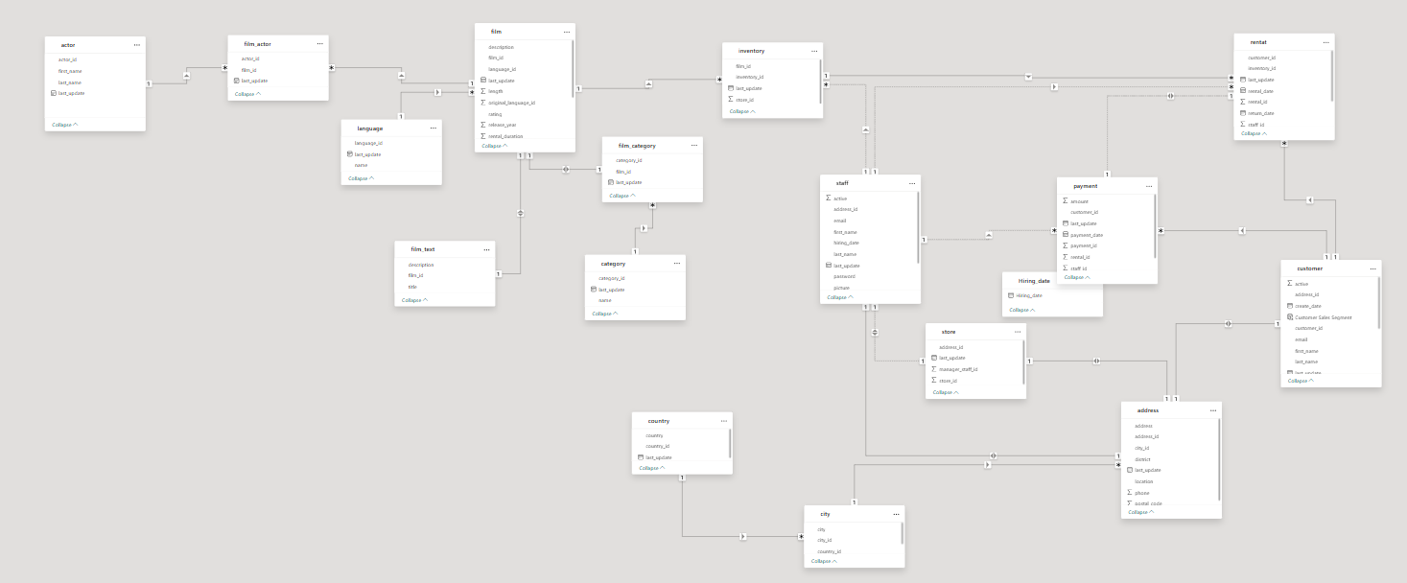
ER Diagram

Slide 5
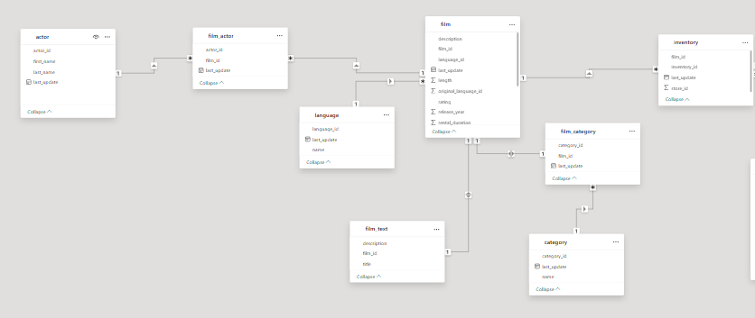

Slide 6
Power BI Problem Statements

Slide 7
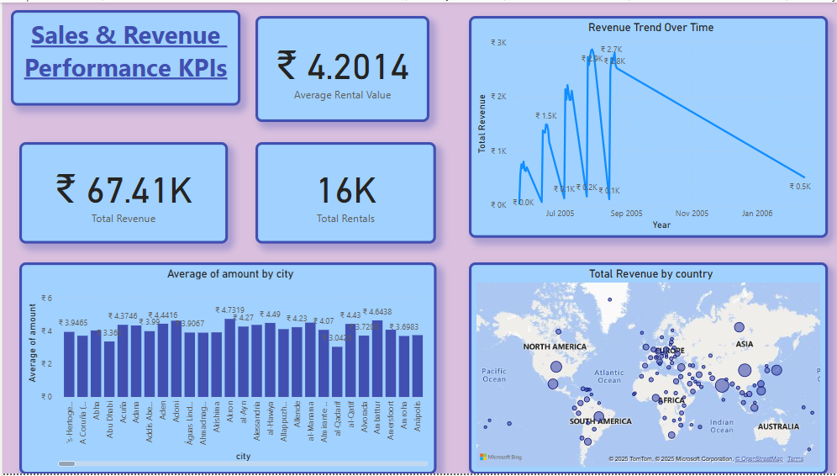

Slide 8
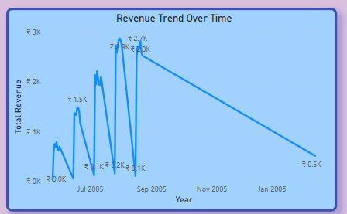
Strong Peak: "We observe a significant peak in revenue around September-October 2005, reaching nearly ₹3K. This suggests a potentially very strong rental period during those months."
Subsequent Decline: "Following this peak, there's a noticeable decline into November 2005 and further into January 2006, dropping to about ₹0.5K."
Potential Seasonality: "This pattern might indicate seasonality, with a strong Q3/Q4 peak in 2005 followed by a slower period towards year-end/new year. Further historical data would confirm this seasonal trend."

Slide 9
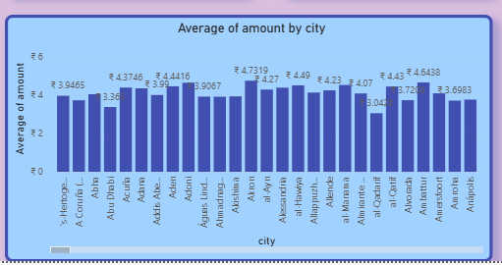
Significant Variation: "There's considerable variation in the average amount customers spend per rental across different cities. Some cities consistently show higher average transaction values (e.g., 'A Coruña', 'Abha'), while others are lower (e.g., 'Apia', 'Ahmadnagar')."
High-Value Locations: "Identifying these cities with higher average rental values is critical as they indicate either customers willing to rent more expensive films, or more items per transaction."

Slide 10
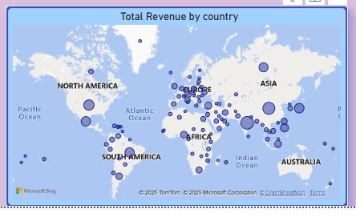
Global Footprint: "This map gives us a quick understanding of our global market reach and where our current revenue hot spots are."
Market Gaps: "It also visually identifies regions where we have little to no revenue, which could represent untapped markets or areas for deeper analysis."

Slide 11
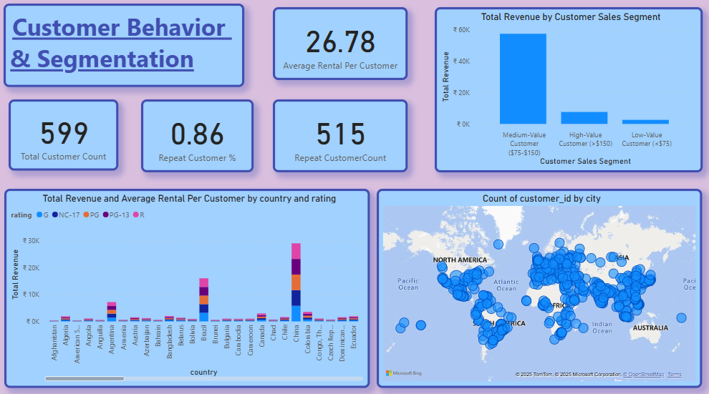

Slide 12
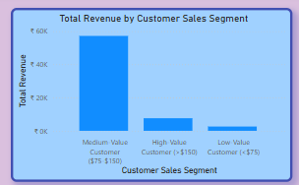
Dominant Segment: "Interestingly, our 'Medium-Value Customers' (defined as spending between ₹75-₹150) generate the highest share of our total revenue, nearing ₹60K. This suggests they form the backbone of our sales."
Contribution from other segments: "The 'High-Value Customers' (spending >₹150) contribute a smaller, though still significant, portion, followed by 'Low-Value Customers' (<₹75)

Slide 13
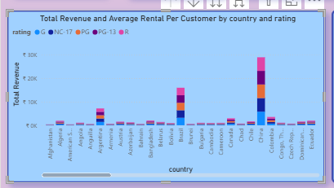
Top Revenue Countries: "Countries like Brazil, Chad, Congo (Rep.), France, and China stand out as major revenue contributors."
Rating Preferences by Country: "Within these top countries, we observe varying preferences for film ratings. For instance, in Brazil, PG-13 (light blue) and R (pink) appear to be dominant revenue drivers. In Chad, PG (green) also contributes significantly."
Market Nuances: "This shows that content strategy needs to be localized. What sells well in one country

Slide 14
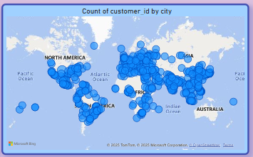
Customer Concentration: "Our customer base is primarily concentrated in specific cities, with large clusters of customers observed in North America (e.g., cities in the USA, Canada) and Europe (e.g., cities in the UK, Germany, France)."
Market Reach: "This map provides an intuitive overview of where our customers are located globally, identifying our core geographic markets."
Untapped Areas: "Regions with smaller or no bubbles suggest areas with lower customer penetration, which could be opportunities for future expansion or targeted outreach."

Slide 15
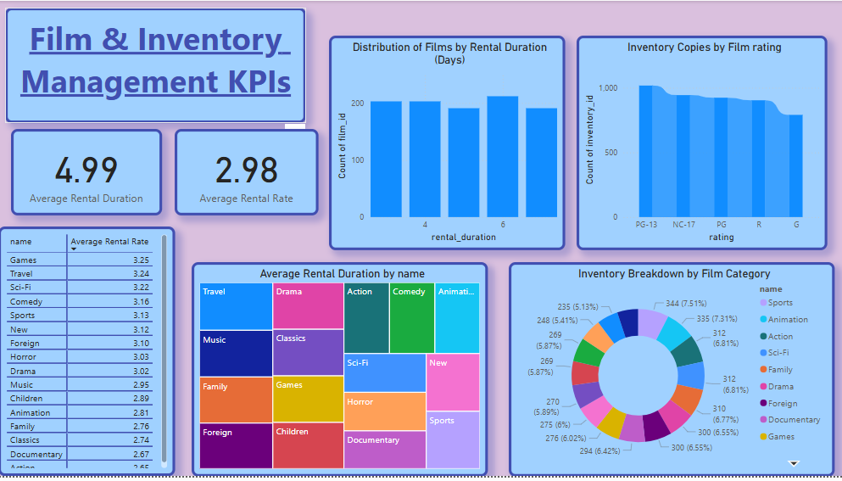

Slide 16
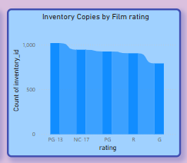
High Inventory in Specific Ratings: "We hold the highest inventory for PG and NC-17 rated films, followed by R and G." (Self-correction/Note: There appears to be a duplicate 'PG' label on the axis, which might represent 'PG-13' or a data quality issue to check in Power BI itself, but the visual intent is clear).
Inventory Alignment: "This distribution shows where our physical assets are concentrated, potentially aligning with the demand for specific content maturity levels.

Slide 17
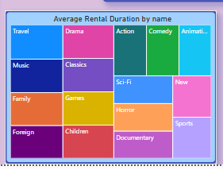
Longest Rental Duration Categories: "Categories like Travel and Drama show noticeably larger tiles, indicating that films in these genres are typically rented for longer average durations."
Shorter Rental Duration Categories: "Conversely, Action and Children films have smaller tiles, suggesting they are rented for shorter average periods."

Slide 18
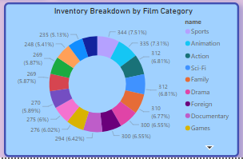
Balanced Inventory: "Our inventory is quite balanced across different film categories. No single category overwhelms the others, with most categories making up around 6-7% of our total inventory."
Diverse Collection: "This indicates a diverse film collection, potentially catering to a wide range of customer preferences."

Slide 19
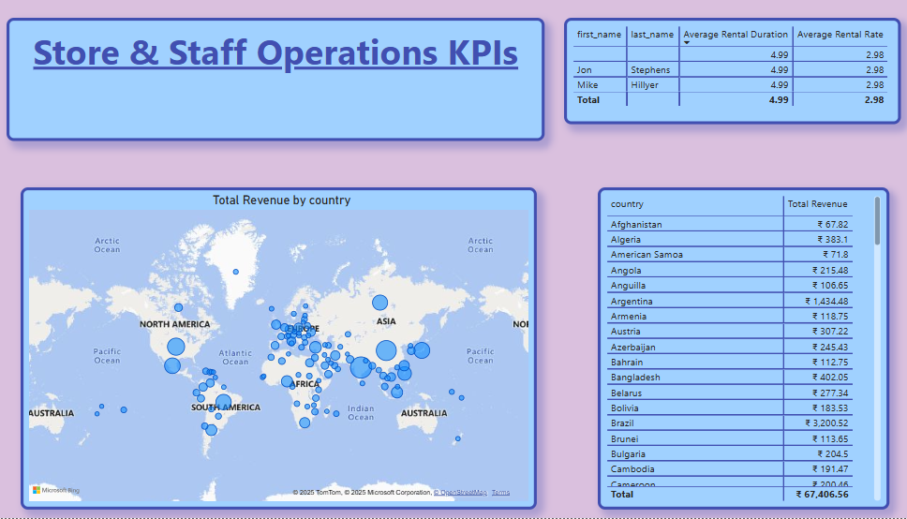

Slide 20
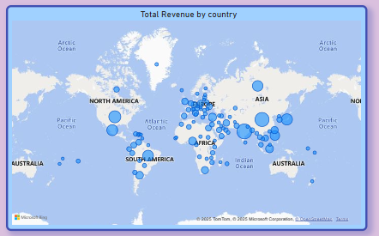
Overall Revenue: "The table confirms our total revenue generated across all visible countries is ₹67,406.56."
High-Contributing Countries: "From the visible portion, Brazil stands out as a significant revenue contributor with ₹3,200.52. Argentina also shows strong revenue at ₹1,434.48." (You'd scroll to identify the absolute top countries from the full list).
Smaller Markets: "Many other countries, such as Afghanistan, Algeria, American Samoa, and others in this view, contribute relatively smaller amounts of revenue individually."
Complement to Map: "While the map visual gives us a quick geographical overview, this table provides the granular numbers, allowing us to identify every country's exact financial contribution."What to Say:
"This table provides the detailed financial breakdown by country. Here, we can see the exact revenue contributed b

